Slide 1
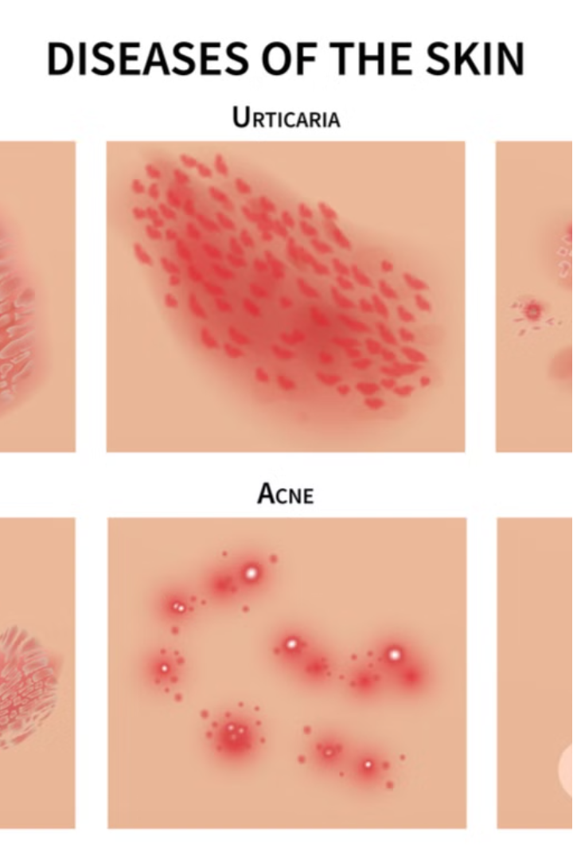

Skin Disease Prediction System
DONE BY
RITHIKA M(210701214)
RUPESH L(210701217)

Slide 2
Challenges in Current Skin Disease Prediction Systems
Current skin disease prediction systems face several significant challenges:
Limited availability of high-quality, diverse training data - this leads to models that are biased and inaccurate, unable to generalize well to diverse patient populations.
Lack of interpretability and explainability in AI models - healthcare providers struggle to understand the reasoning behind model predictions, hindering trust and adoption.
Integration challenges with clinical workflows - seamless integration into existing healthcare systems is crucial for enabling widespread use and maximizing the real-world impact of these prediction tools.
Addressing these challenges is essential to develop skin disease prediction systems that are robust, trustworthy, and truly beneficial for patients and clinicians alike.

Slide 3
Skin Disease Prediction System
1
Leverages custom-built CNN model
2
Analyzes skin condition images
Identifies a wide range of dermatological diseases with high accuracy
Developed using TensorFlow, a leading open-source machine learning framework
3
Transparent inner workings
4
Designed for seamless integration
Allows clinicians to understand the reasoning behind each diagnosis
Enables easy adoption and maximizes real-world impact

Slide 4
How It Works
1
1. Image Uploaded
2
2. ML Algorithm Applied
3
3. Results Displayed
The image is uploaded into the Flask API.
The output is displayed in an HTML page for the user.
The image is sent into the machine learning algorithm for analysis.

Slide 5
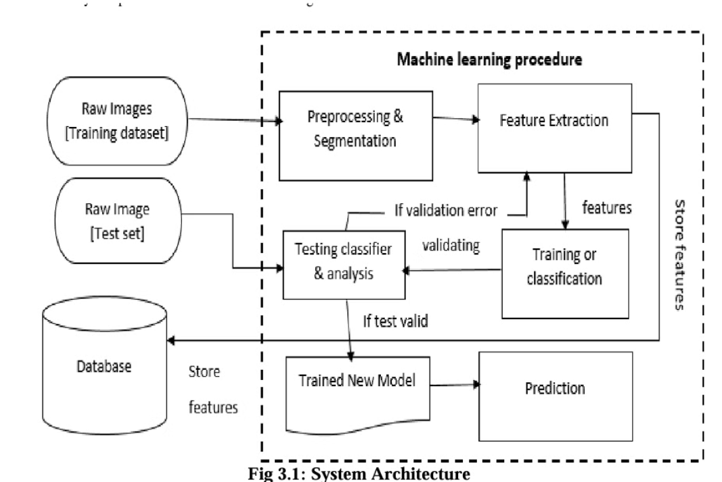
Proposed System

Slide 6
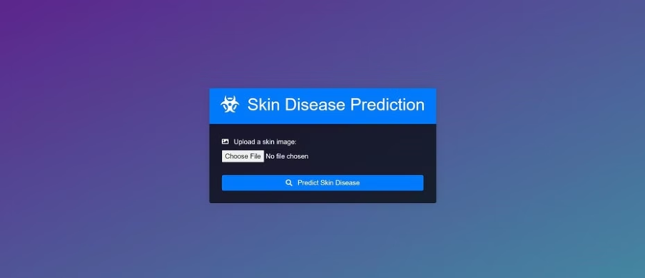
Visualization of working
User Interface page

Slide 7
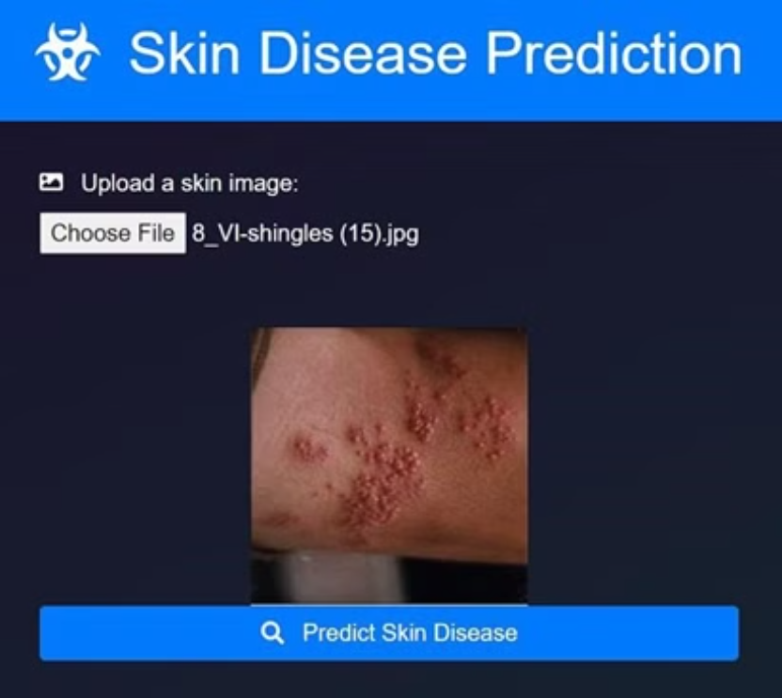
Upload Preview

Slide 8
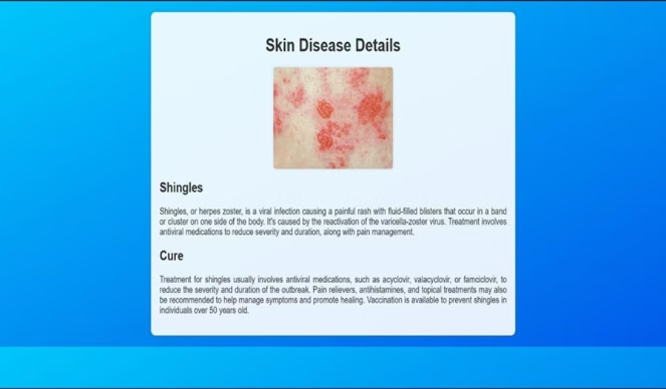
Results Page

Slide 9
Conclusion
In summary, the Skin Disease Prediction System leverages cutting-edge deep learning technology to accurately identify a wide range of dermatological conditions. By addressing key challenges in current systems, this solution provides clinicians with a robust, transparent, and seamlessly integrated tool to better serve their patients. Looking ahead, continued research and innovation in this space will further transform the future of skin disease diagnosis and management.

Slide 10

Thank You
We would like to express our sincere gratitude for your time and attention throughout this presentation. Your valuable feedback and insights have been instrumental in shaping the development of our Skin Disease Prediction System.
We are committed to continuously improving our solution to better serve the needs of healthcare providers and patients alike.

Slide 11
References
[1] F. Millstein, Convolutional Neural Networks In Python: Beginner’s Guide To Convolutional Neural Networks In Python. Frank Millstein, 2020.
[2] J. Brownlee, Deep Learning for Computer Vision: Image Classification, Object Detection, and Face Recognition in Python. Machine Learning Mastery, 2019.
[3] K. Saitoh, Deep Learning from the Basics: Python and Deep Learning: Theory and Implementation. Packt Publishing Ltd, 2021.
[4] A. Fandango, Mastering TensorFlow 1.x: Advanced machine learning and deep learning concepts using TensorFlow 1.x and Keras. Packt Publishing Ltd, 2018.
[5] R. Dua and M. S. Ghotra, Keras Deep Learning Cookbook: Over 30 recipes for implementing deep neural networks in Python. Packt Publishing Ltd, 2018.
[6] D. Project, Hands-on Scikit-Learn for Machine Learning Applications: Data Science Fundamentals with Python. Apress, 2019.
[7] M. Grinberg, Flask Web Development: Developing Web Applications with Python. “O’Reilly Media, Inc.,” 2018.

